Slide 1

Riding the Sour Train: Building surtoget.no with Gleam

Slide 2
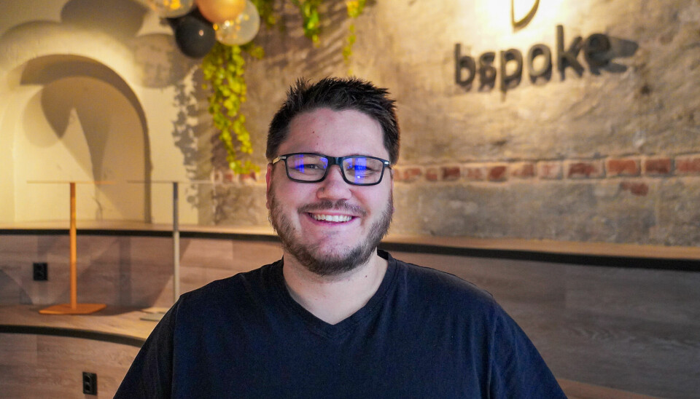

Developer/tech lead/architect
Worked with startups, healthcare, insurance, banking, transportation and stuff.
Bad at FE

Slide 3
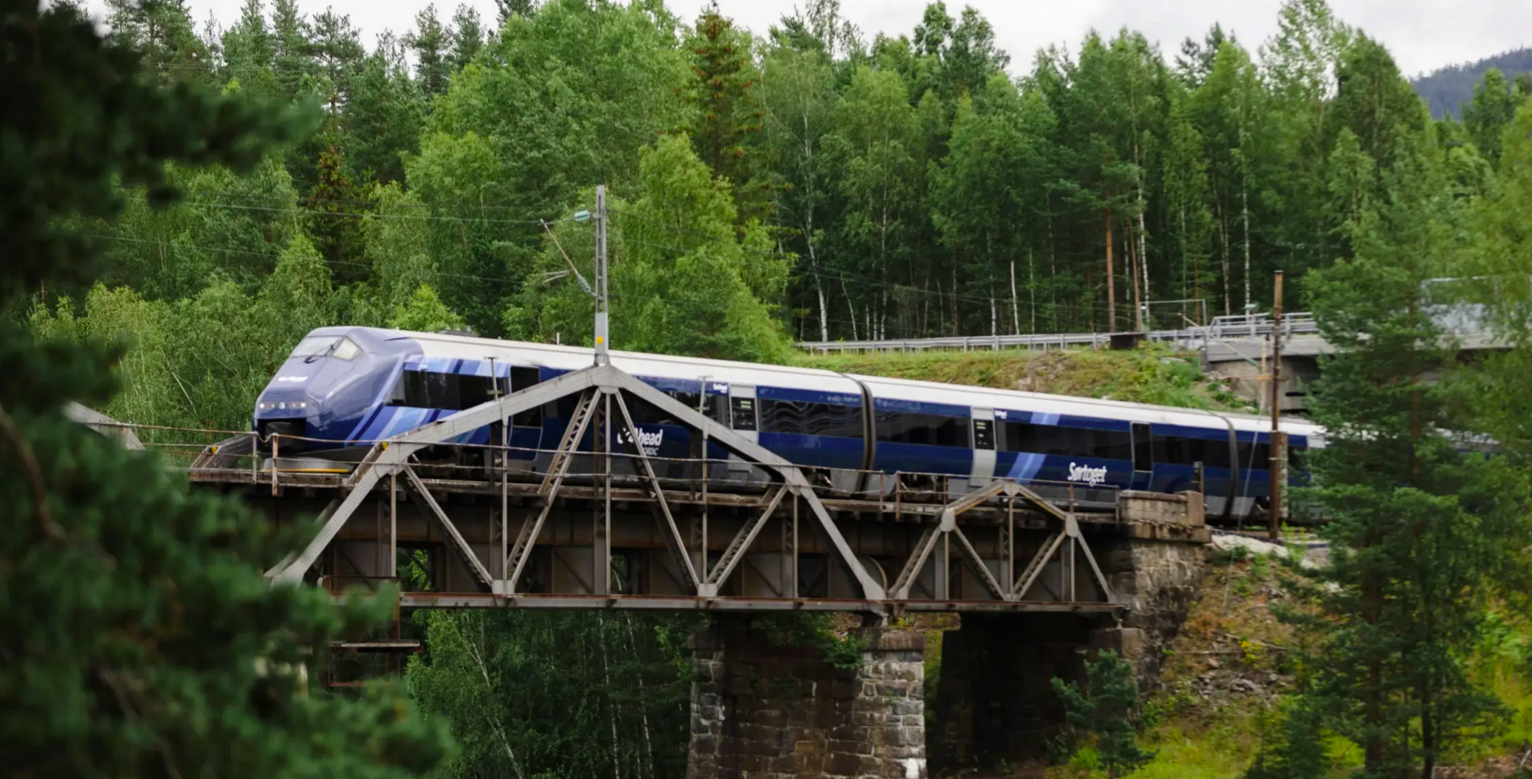

This talk
Notes:
Bettering some part of society? And doing so with gleam

Slide 4
This talk

Slide 5
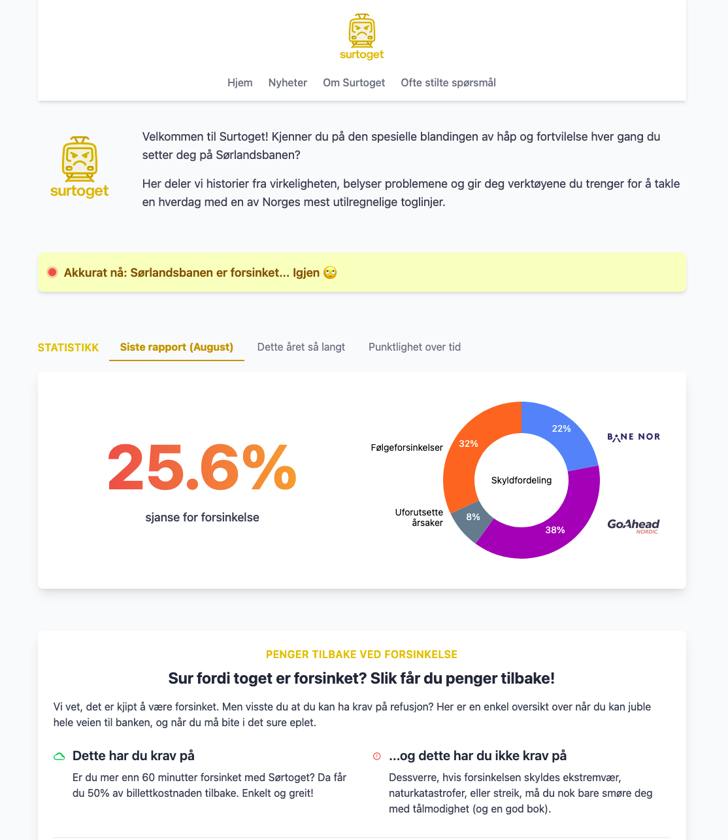

Slide 6



Slide 7
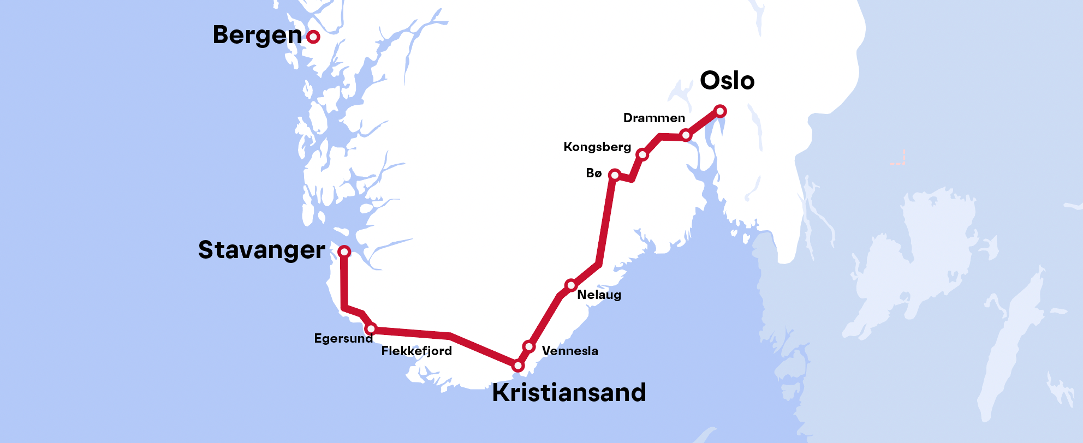
But what is a Sørlandsbanen anyway?
Lunde
Notes:
This is Sørlandsbanen, the main train line for the south of Norway with a whole of 700.000 passangers a year. This can be compared to 67.7 million which travels between London and Birmingham

Slide 8
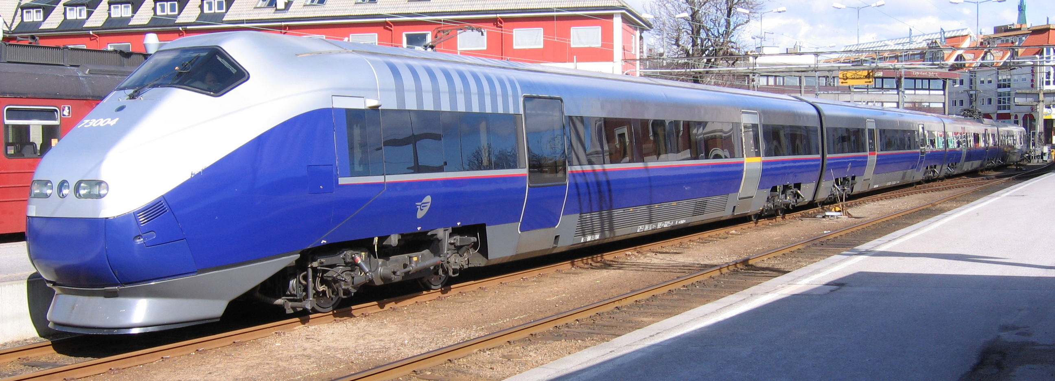
But what is a Sørlandsbanen anyway?
Strømmen
Type 73 (20)
Lunde
Notes:
- First part was opened in 1871, then we spent the about 70 years doing bits an pieces.
Then the Gemrans came along and occupied Norway during ww2 and completed Sørlandsbanen in 1944.
We electrified it in 1956 and added double tracks here and there. Beyond that: Very little has happened except for regular maintenance.
In 1999-2001 we decided we wanted some new trains. Though we contracted the German company Adtranz, the trains themselves was designed and manufactured in Norway.
We got a whopping 20 of them and creatively named them Type 73.

Slide 9
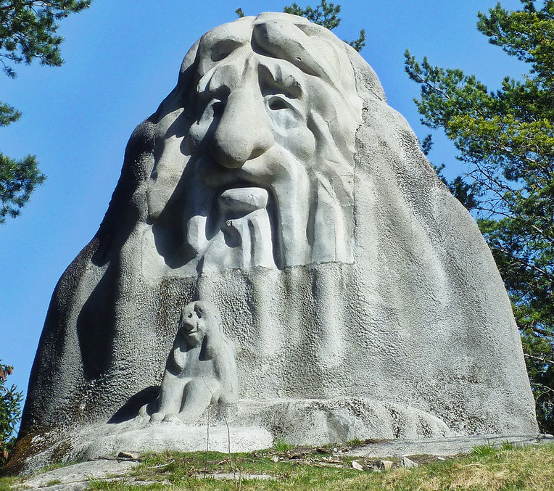
But what is a Sørlandsbanen anyway?
Lunde
Notes:
KollenTrollet – A statue of a troll.

Slide 10
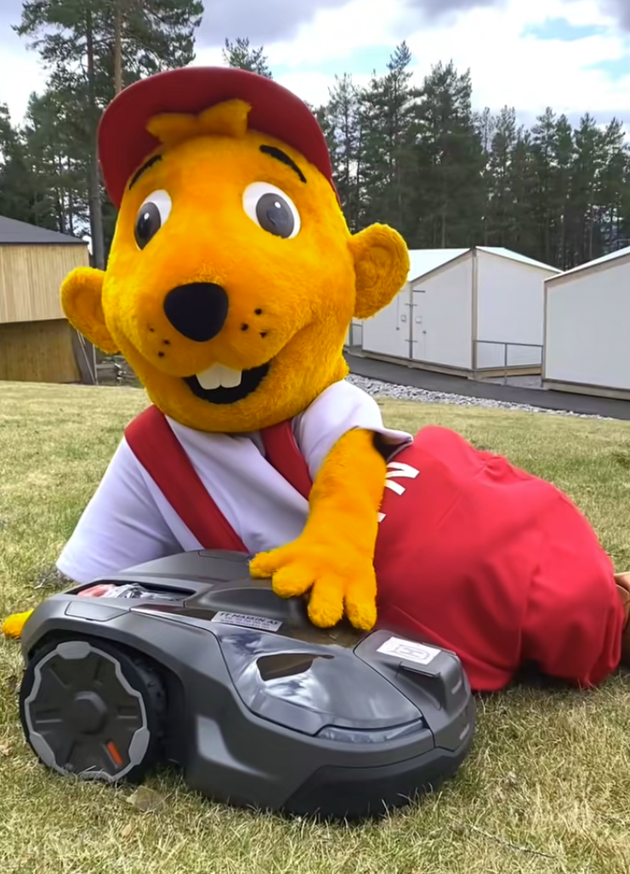
But what is a Sørlandsbanen anyway?
Lunde
Notes:
Bøvern – No I will not go into detail.

Slide 11
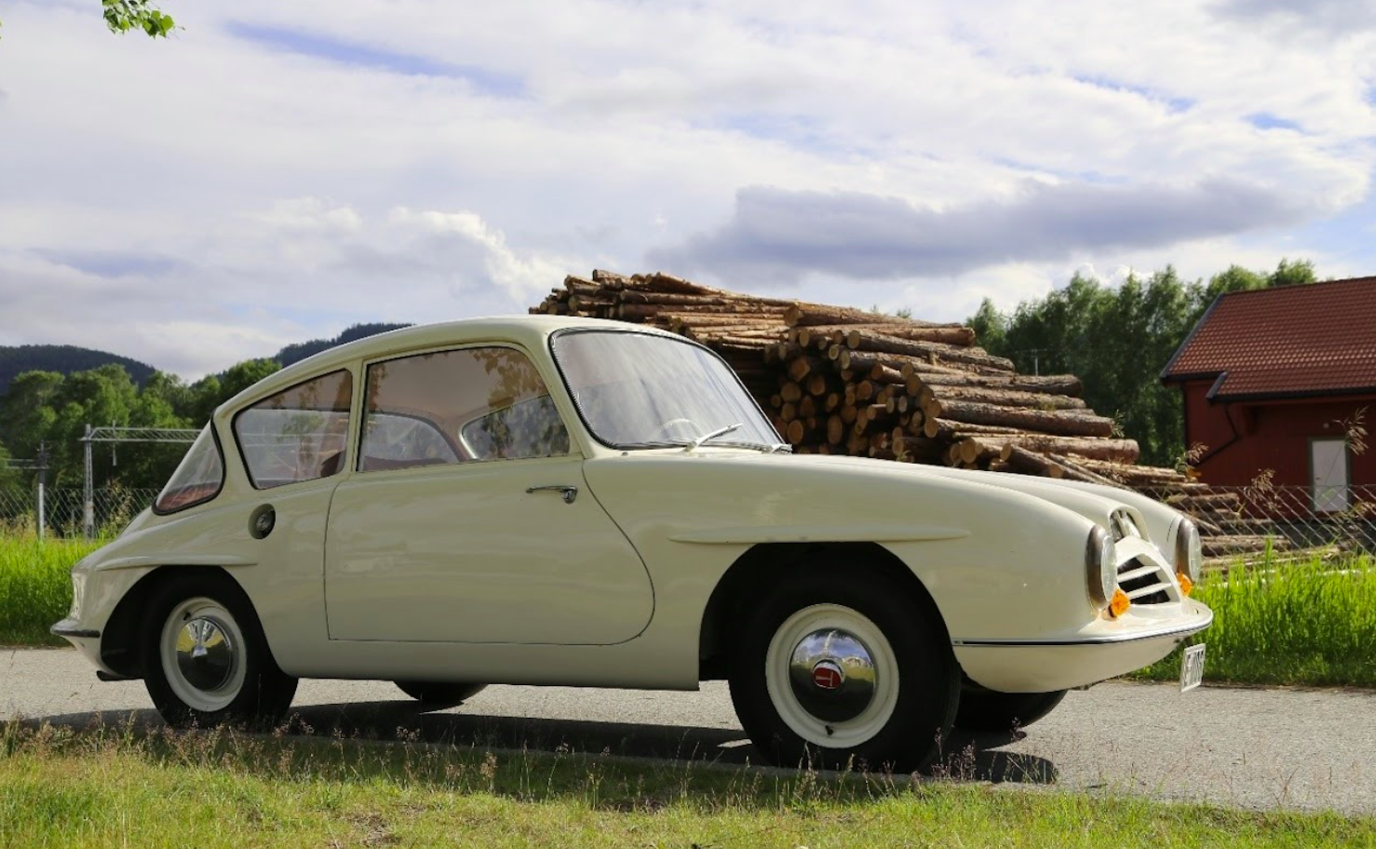
But what is a Sørlandsbanen anyway?
Lunde
Notes:
My hometown, Lunde, which created the first Norwegian produced car: Trollbilen. It was a smashing success and we neded up producing a whopping 3 cars in total.

Slide 12

But what is a Sørlandsbanen anyway?
Lunde
Notes:
And in Kristiansand we find Julius. In Norway he has his own songs, books and tv shows. Why? I don’t know but I guess people like monkeys.

Slide 13
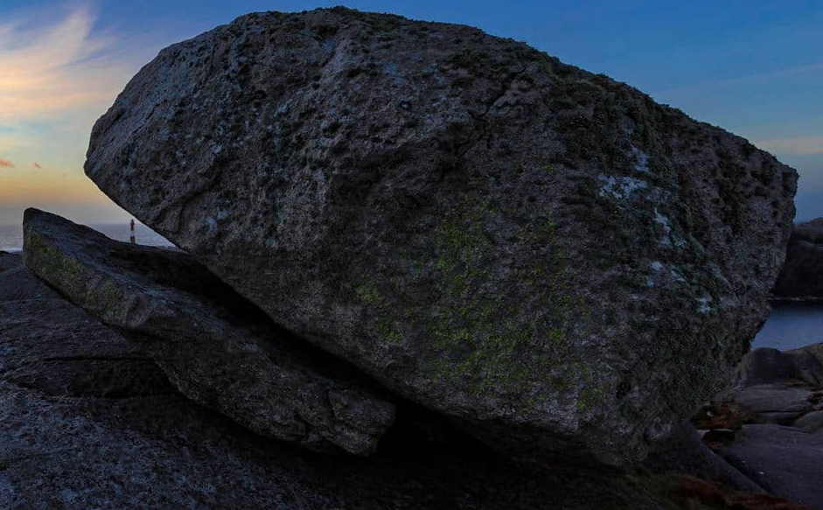
But what is a Sørlandsbanen anyway?
Lunde
Notes:
Now this is interesting. I had to google what is going on in Egersund and I found this stone.

Slide 14
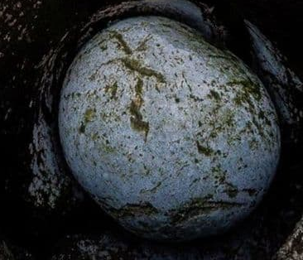
But what is a Sørlandsbanen anyway?
Lunde
Notes:
And this stone.

Slide 15
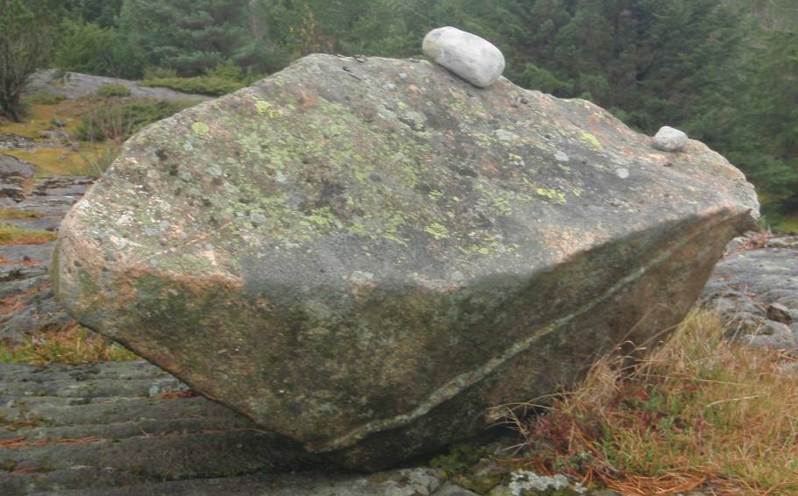
But what is a Sørlandsbanen anyway?
Lunde
Notes:
And that stone. And guess what? They have no historical or cultural significance. They’re just rocks that someone found and thought were cool. And now they’re listed as tourist attractions.

Slide 16
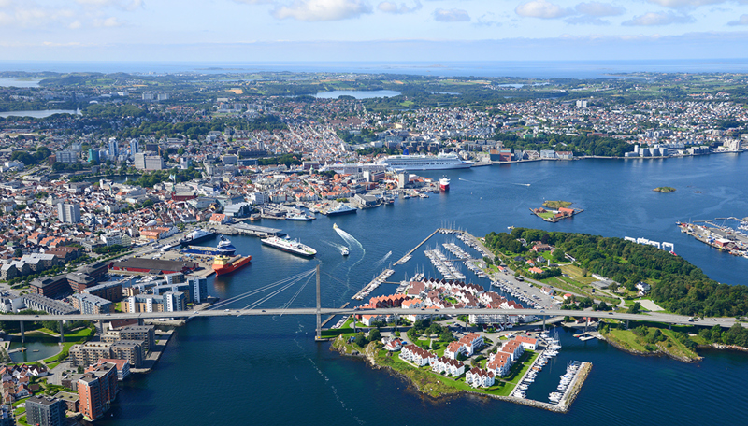
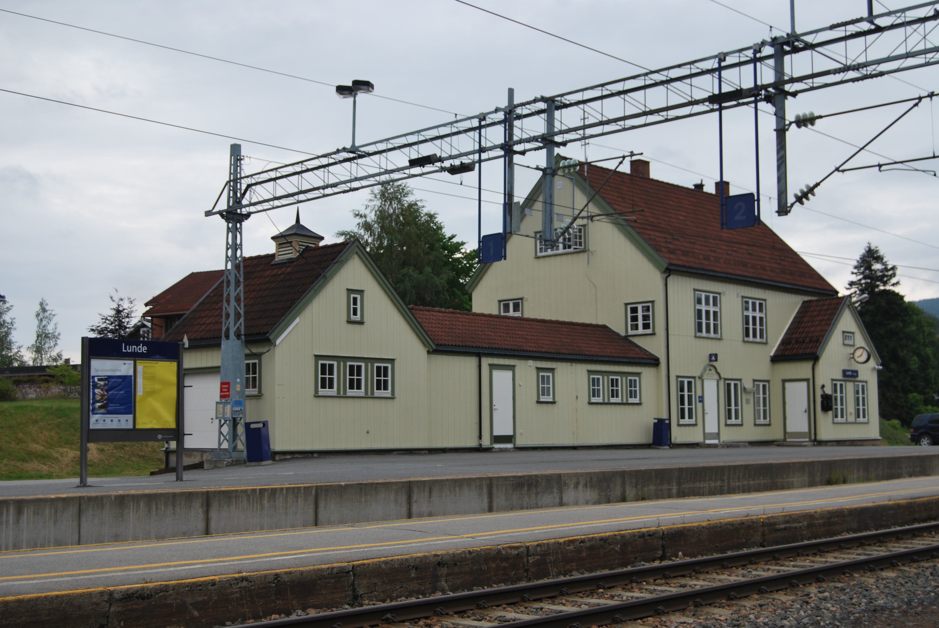
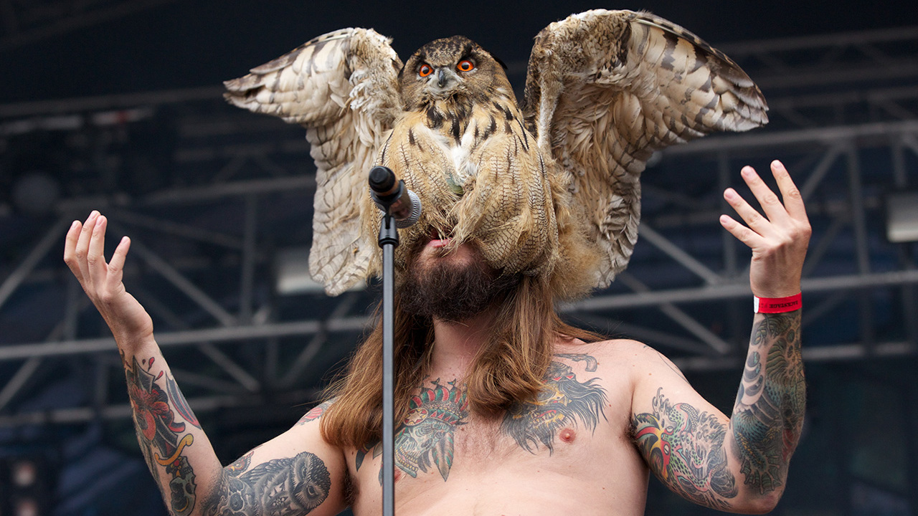
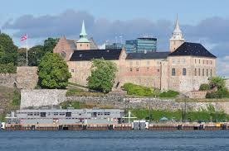
But what is a Sørlandsbanen anyway?
Lunde
Notes:
And then we end up in Stavanger which is a silly place and we shouldn’t give it more attention than we already have.

Slide 17
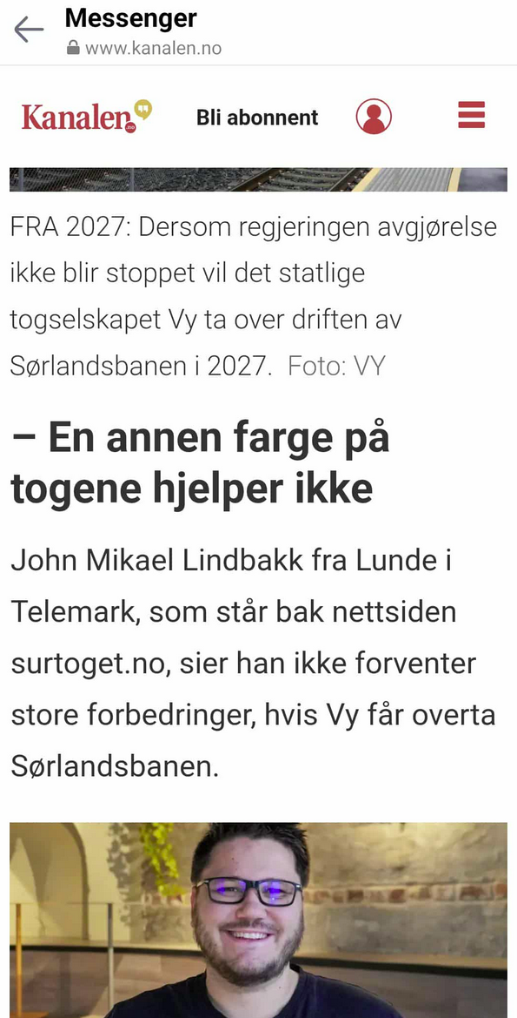
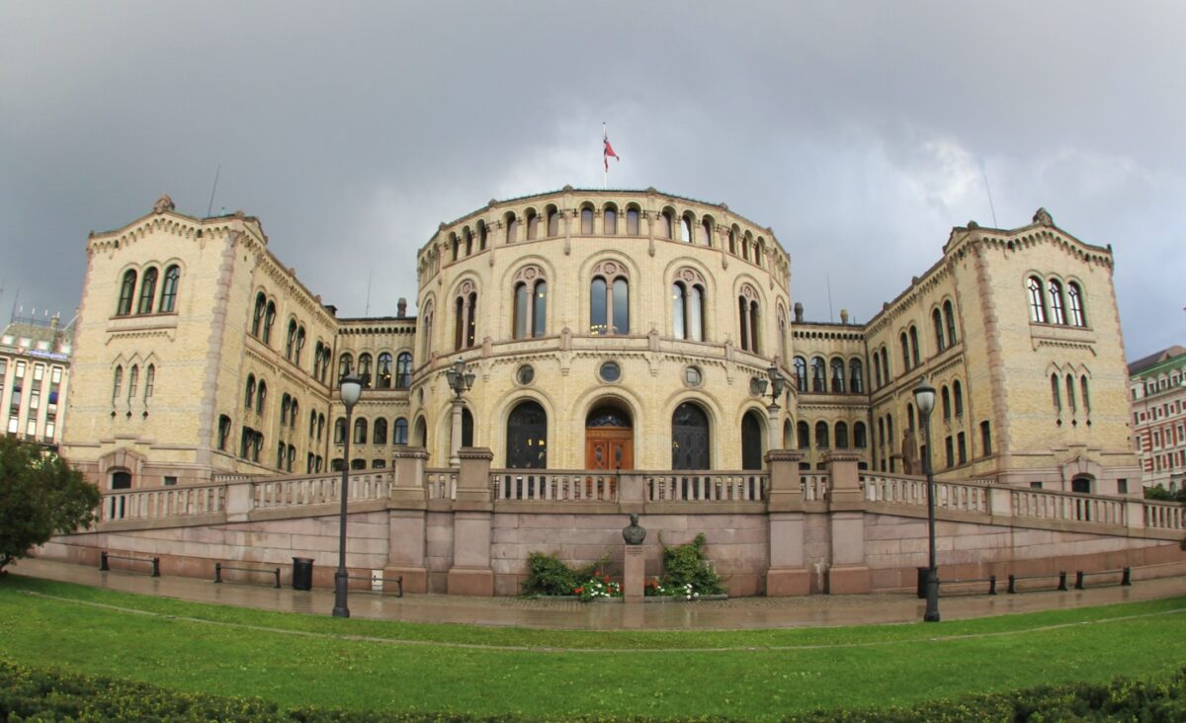

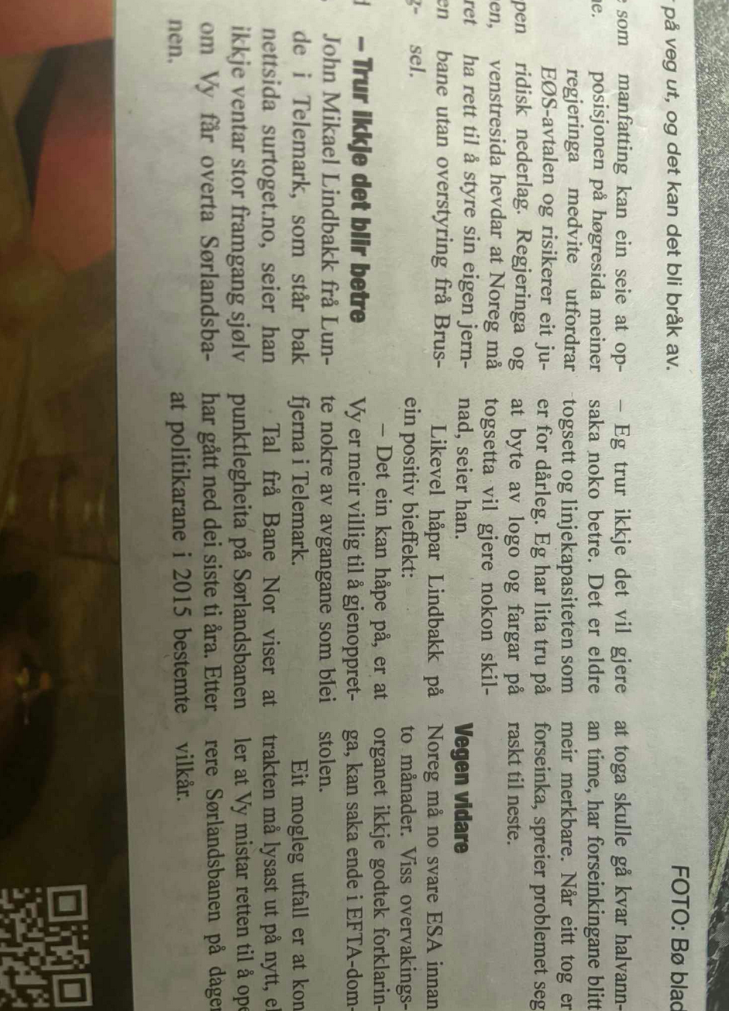
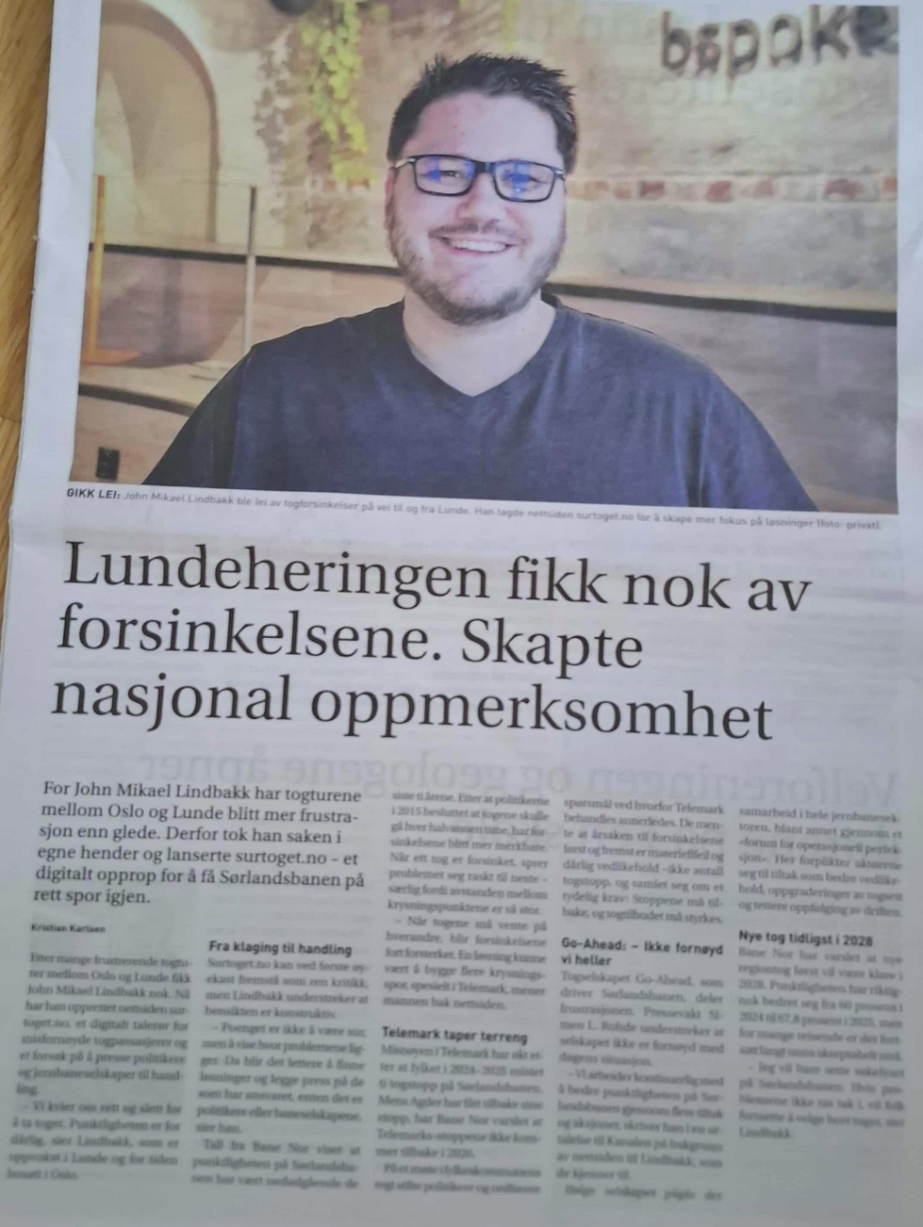

Notes:
Now that we have explored the entierty of Norwegian culture and the complete importance of Sørlandsbanen, let’s talk about the impact surtoget has had.

Slide 22
Developers are uniquely positioned to expose problems

Slide 23
Developers are uniquely equipped to turn their craft into social impact

Slide 24
Typing

Slide 25
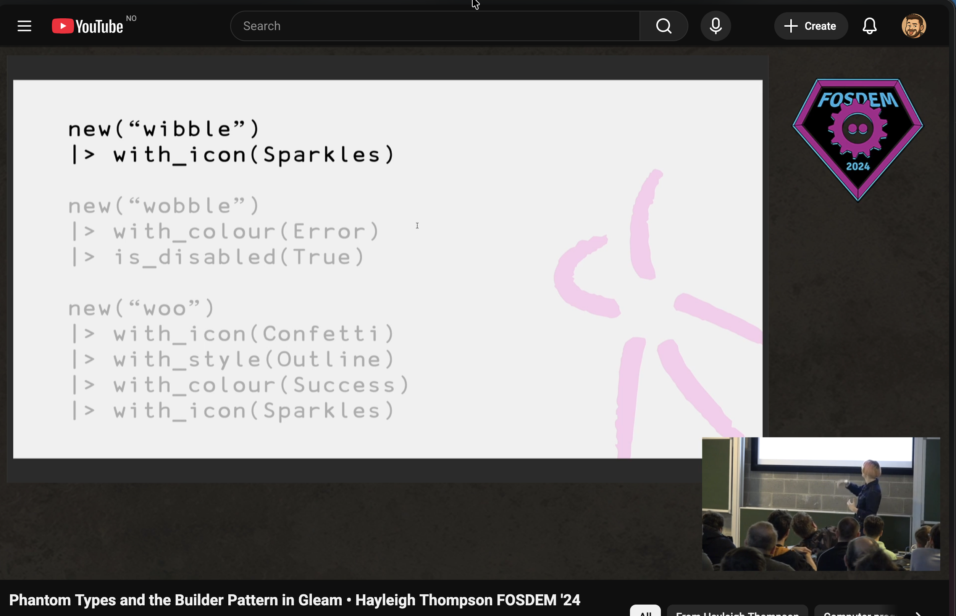
Link: https://www.youtube.com/watch?v=3lYHFctx2Ks

Slide 26
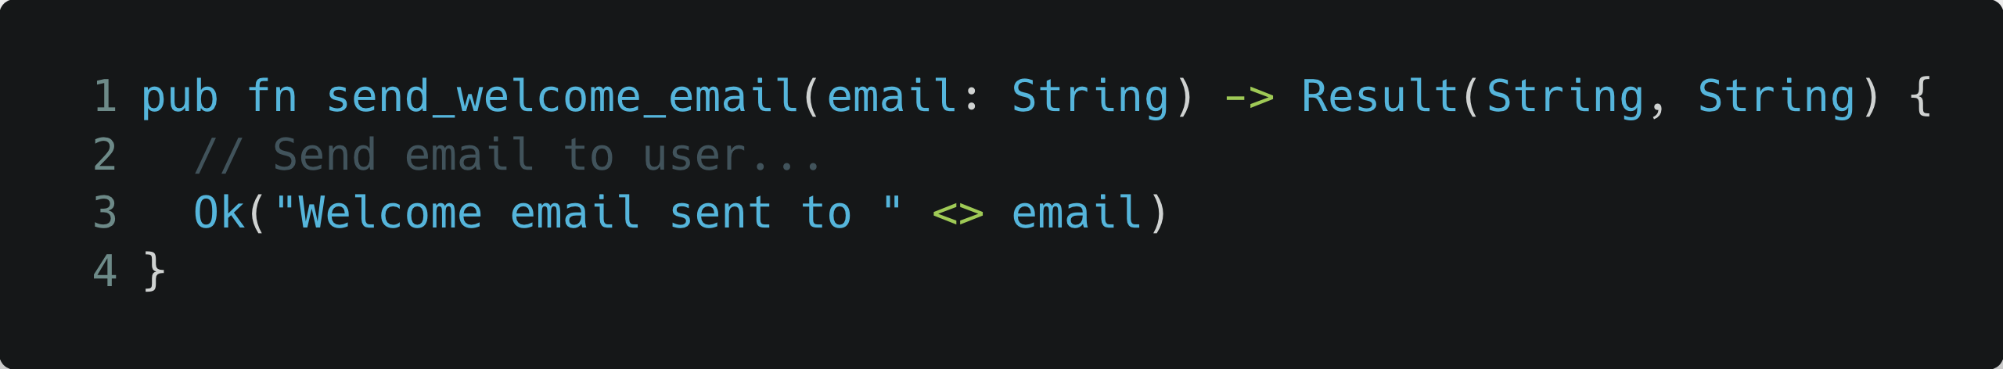

Slide 27
Is this a valid email?

Slide 28
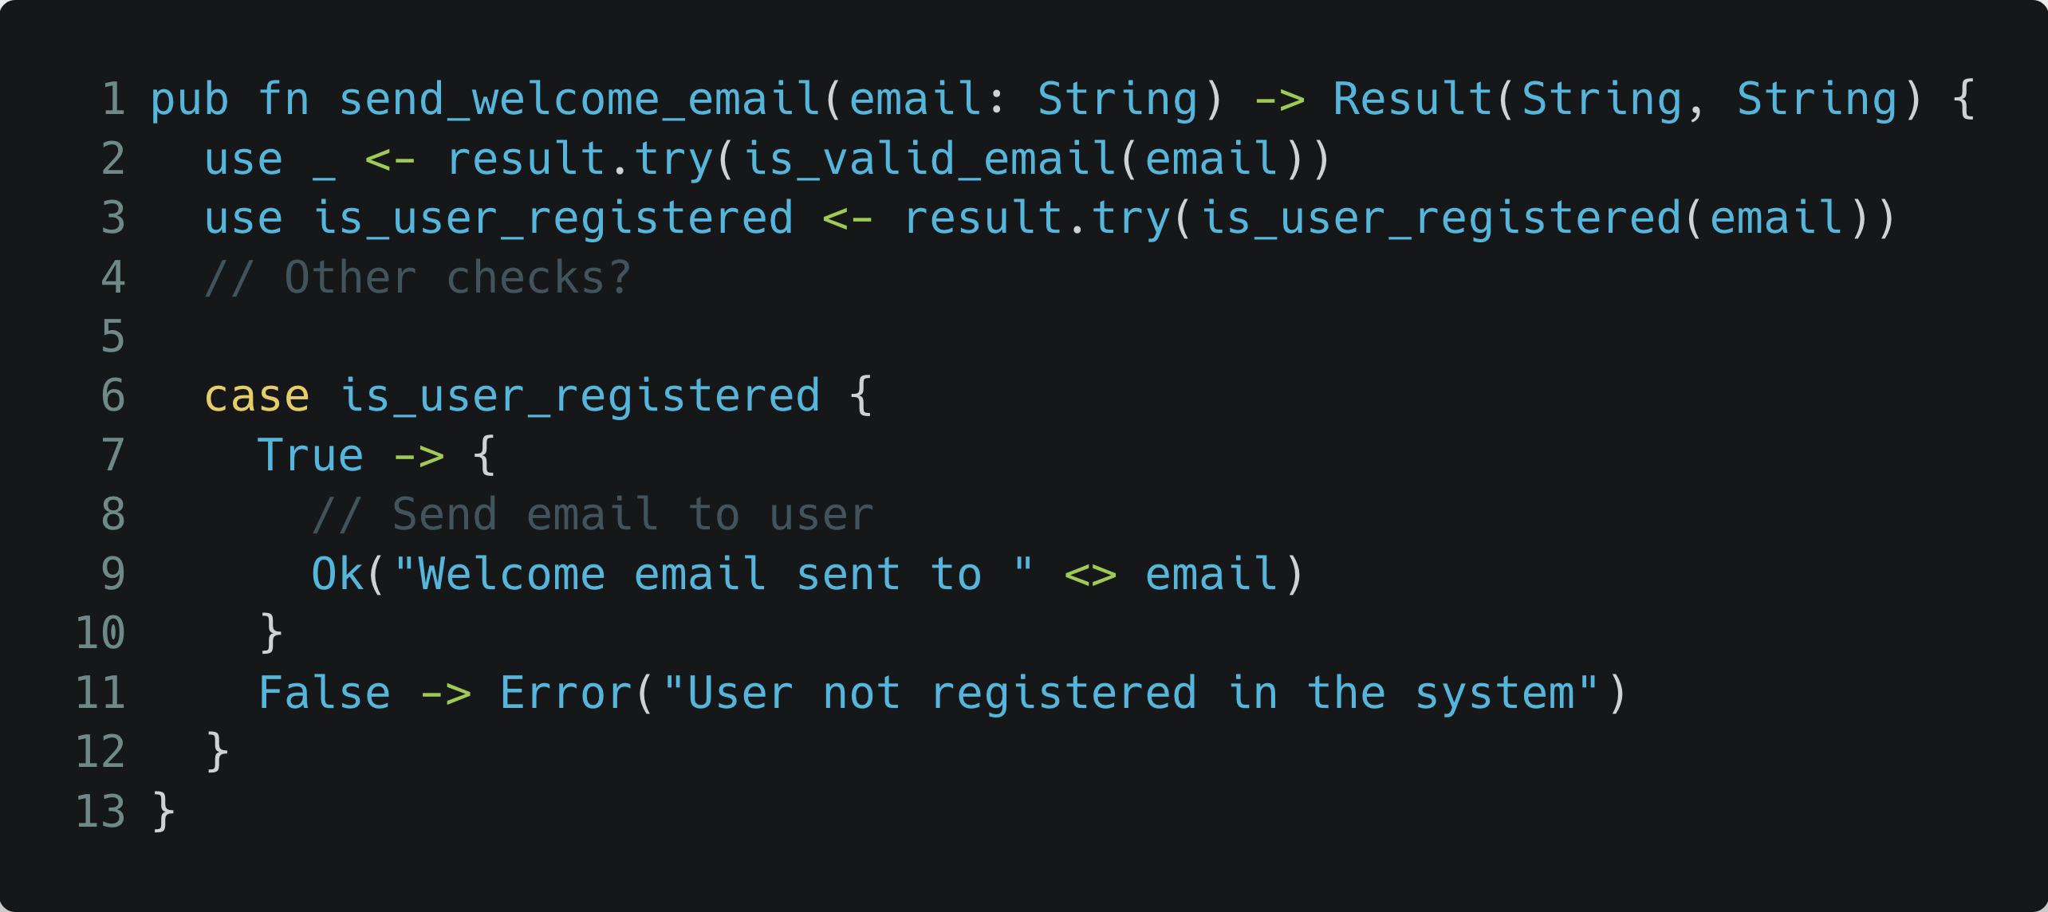

Slide 29
Dependencies and tight coupling

Slide 30
Validation failure
Communication failure

Slide 31
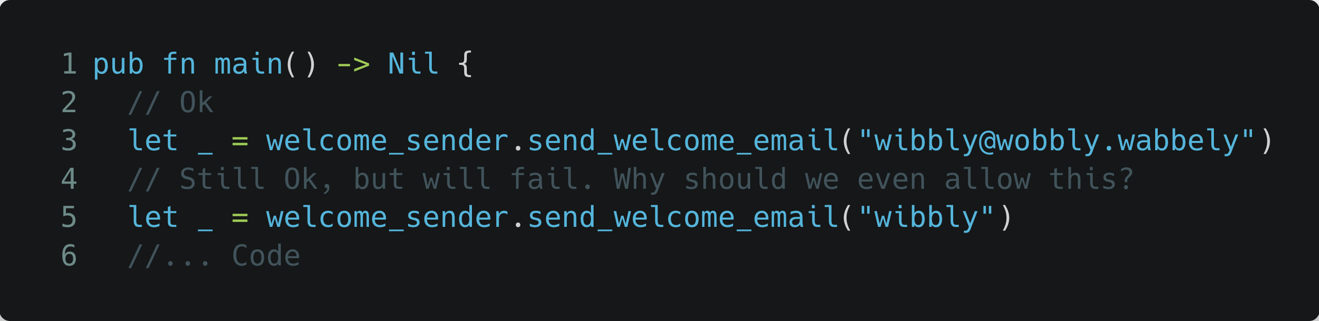

Slide 32
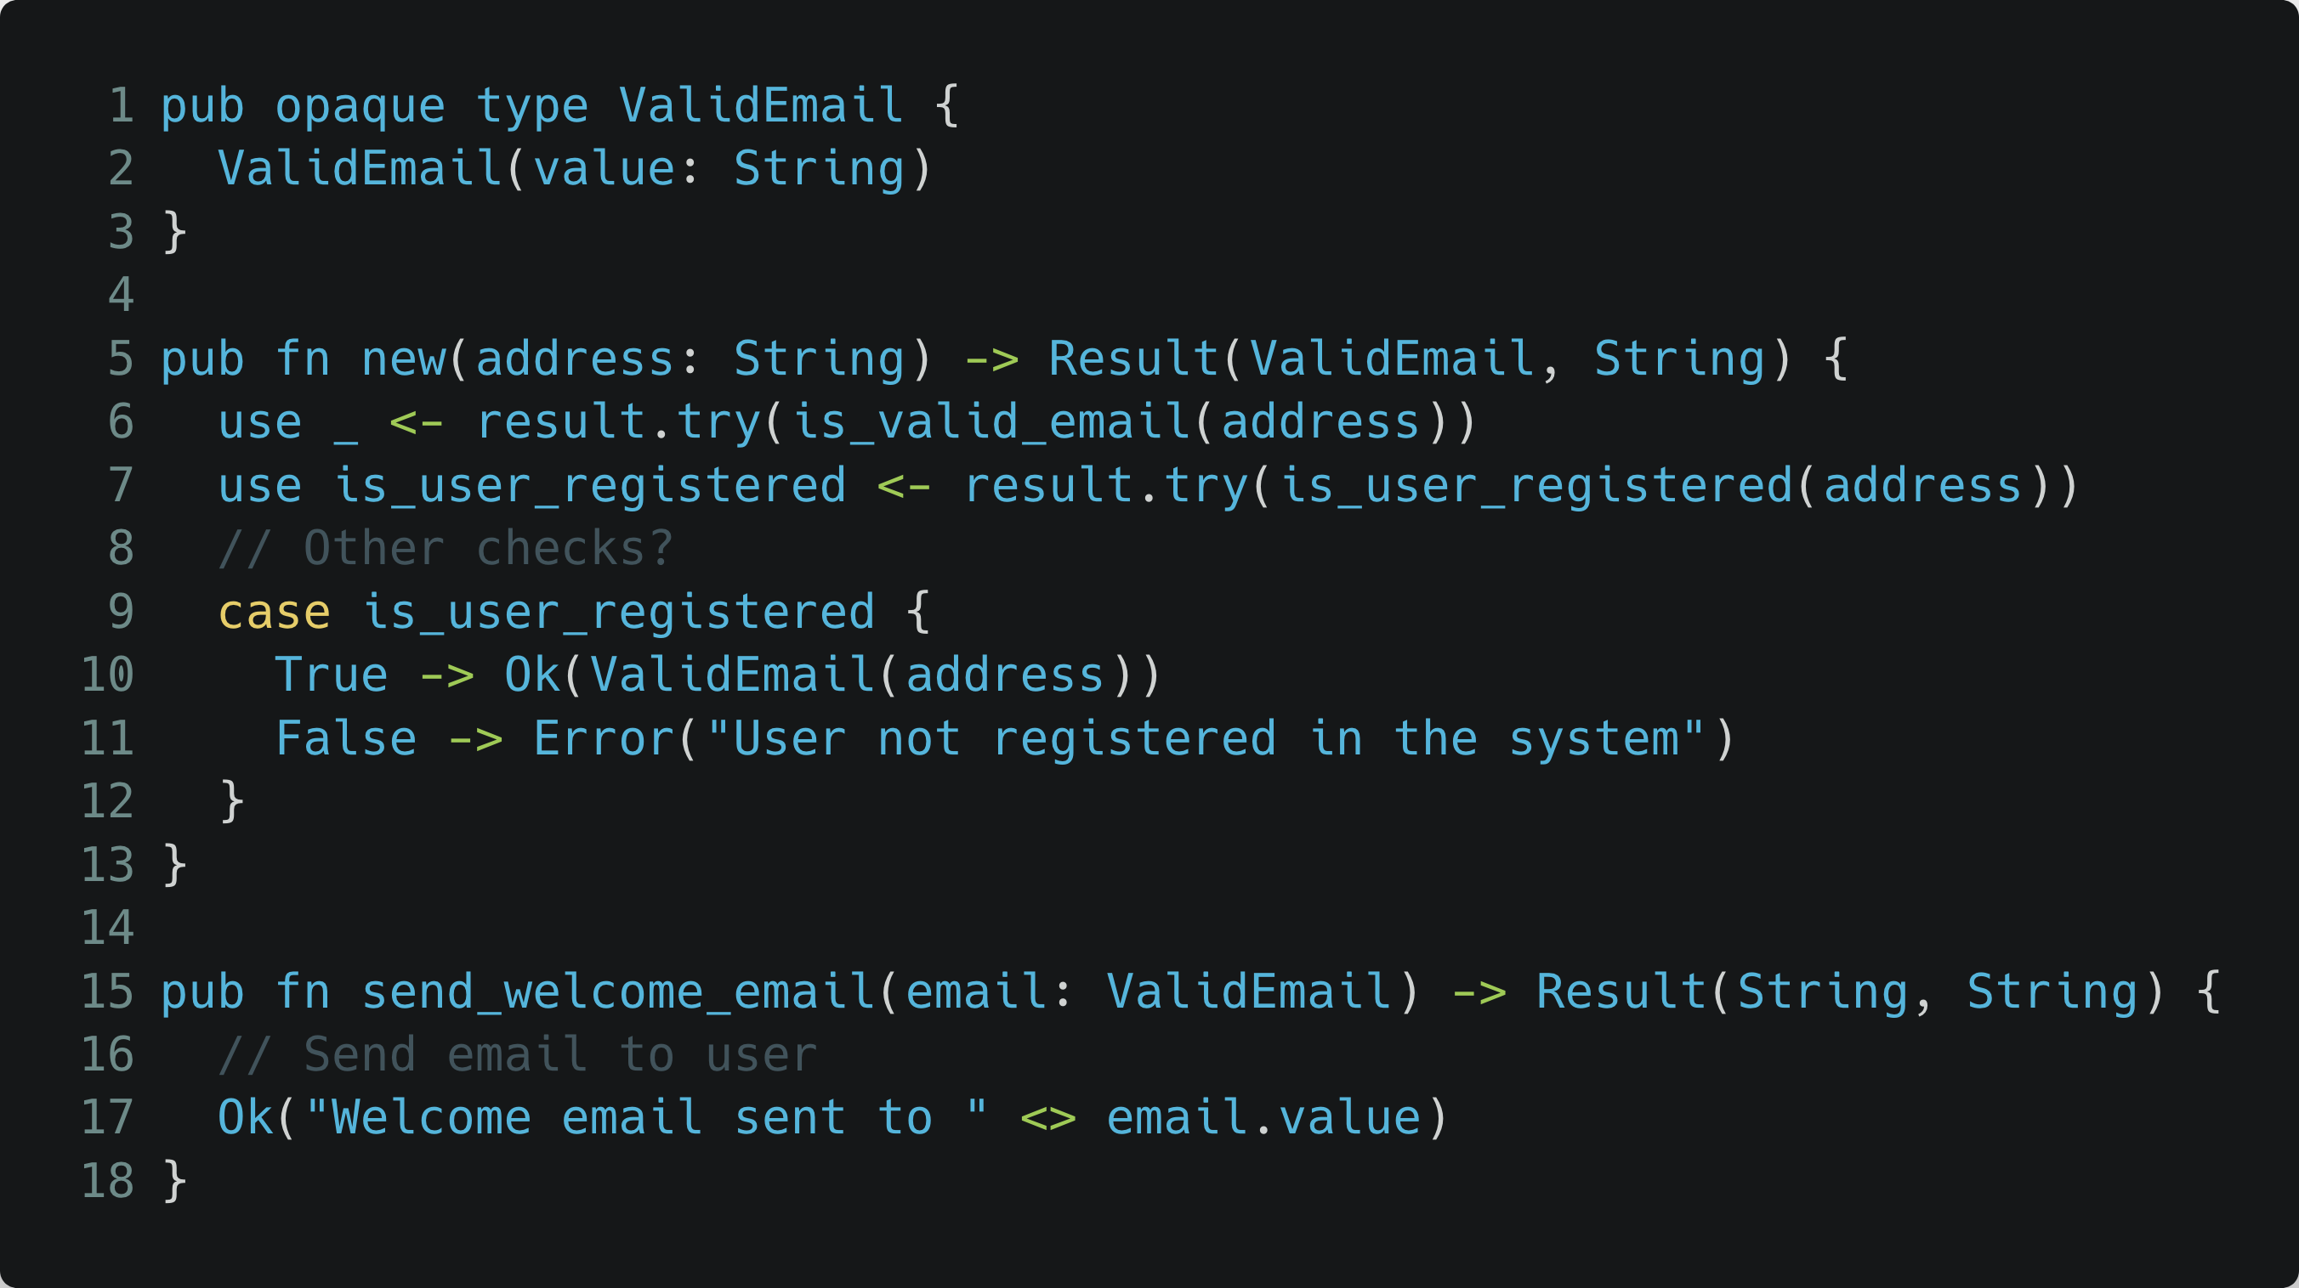

Slide 33
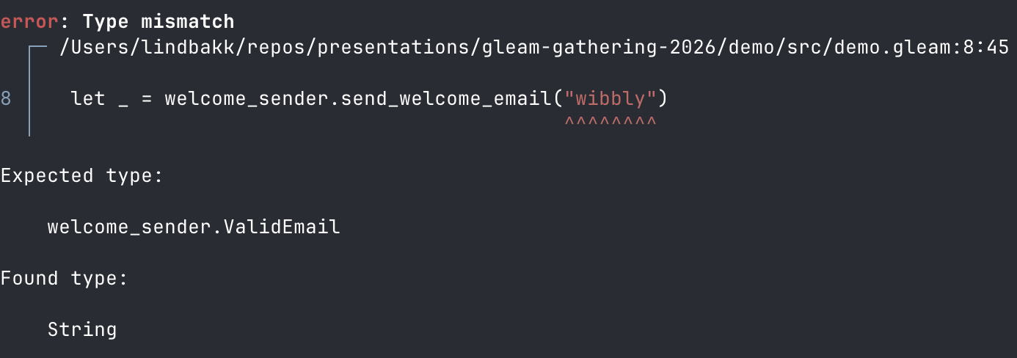

Slide 34
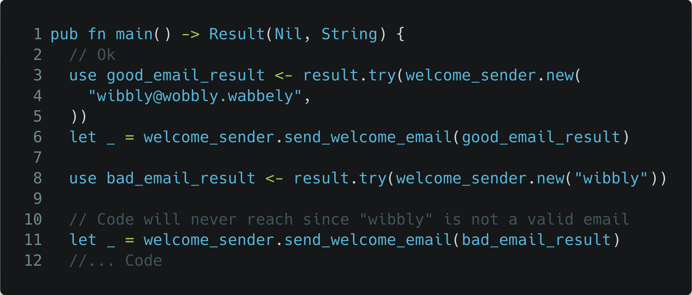

Slide 37

email_validator.gleam
welcome_sender.gleam

Slide 38
email_validator.gleam
welcome_sender.gleam
newsletter_sender.gleam
dark_pattern_sender.gleam
Notes:
- Enforcing correctness across multiple different senders

Slide 39
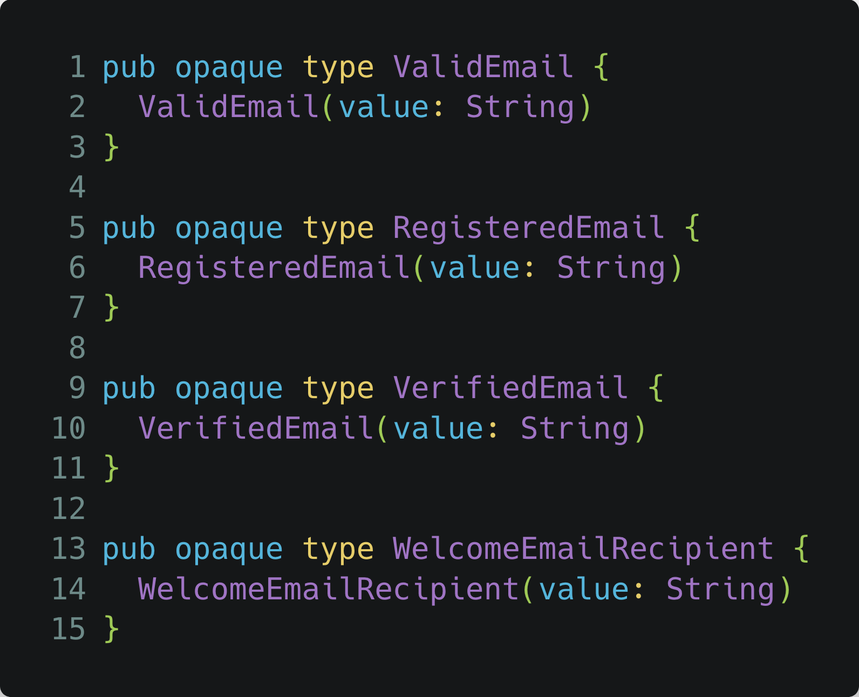
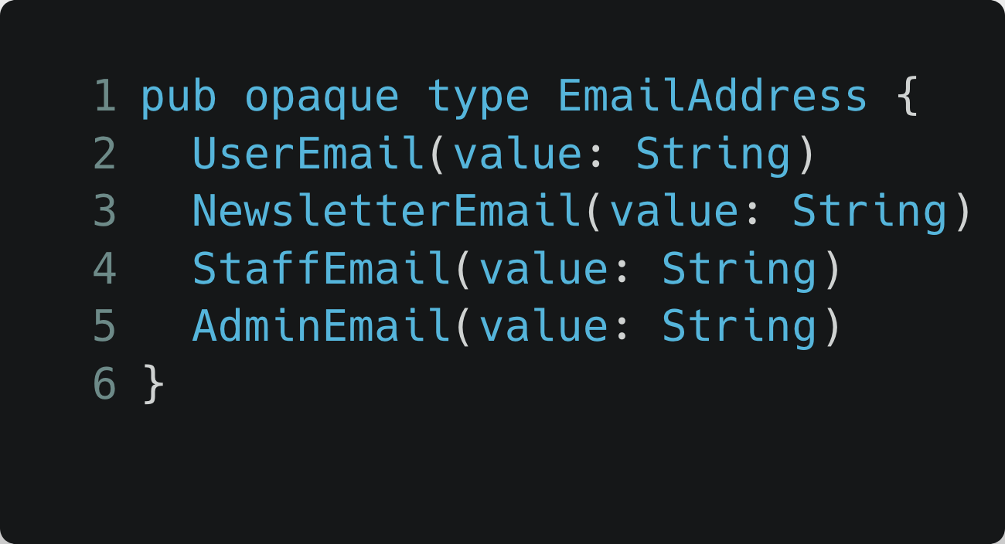
Web API
Batch jobs
email_validator.gleam
welcome_sender.gleam
Other?
newsletter_sender.gleam
dark_pattern_sender.gleam
All forced to validate!
Notes:
- Enforcing safe re-use regardless of where the usage comes from!

Slide 40
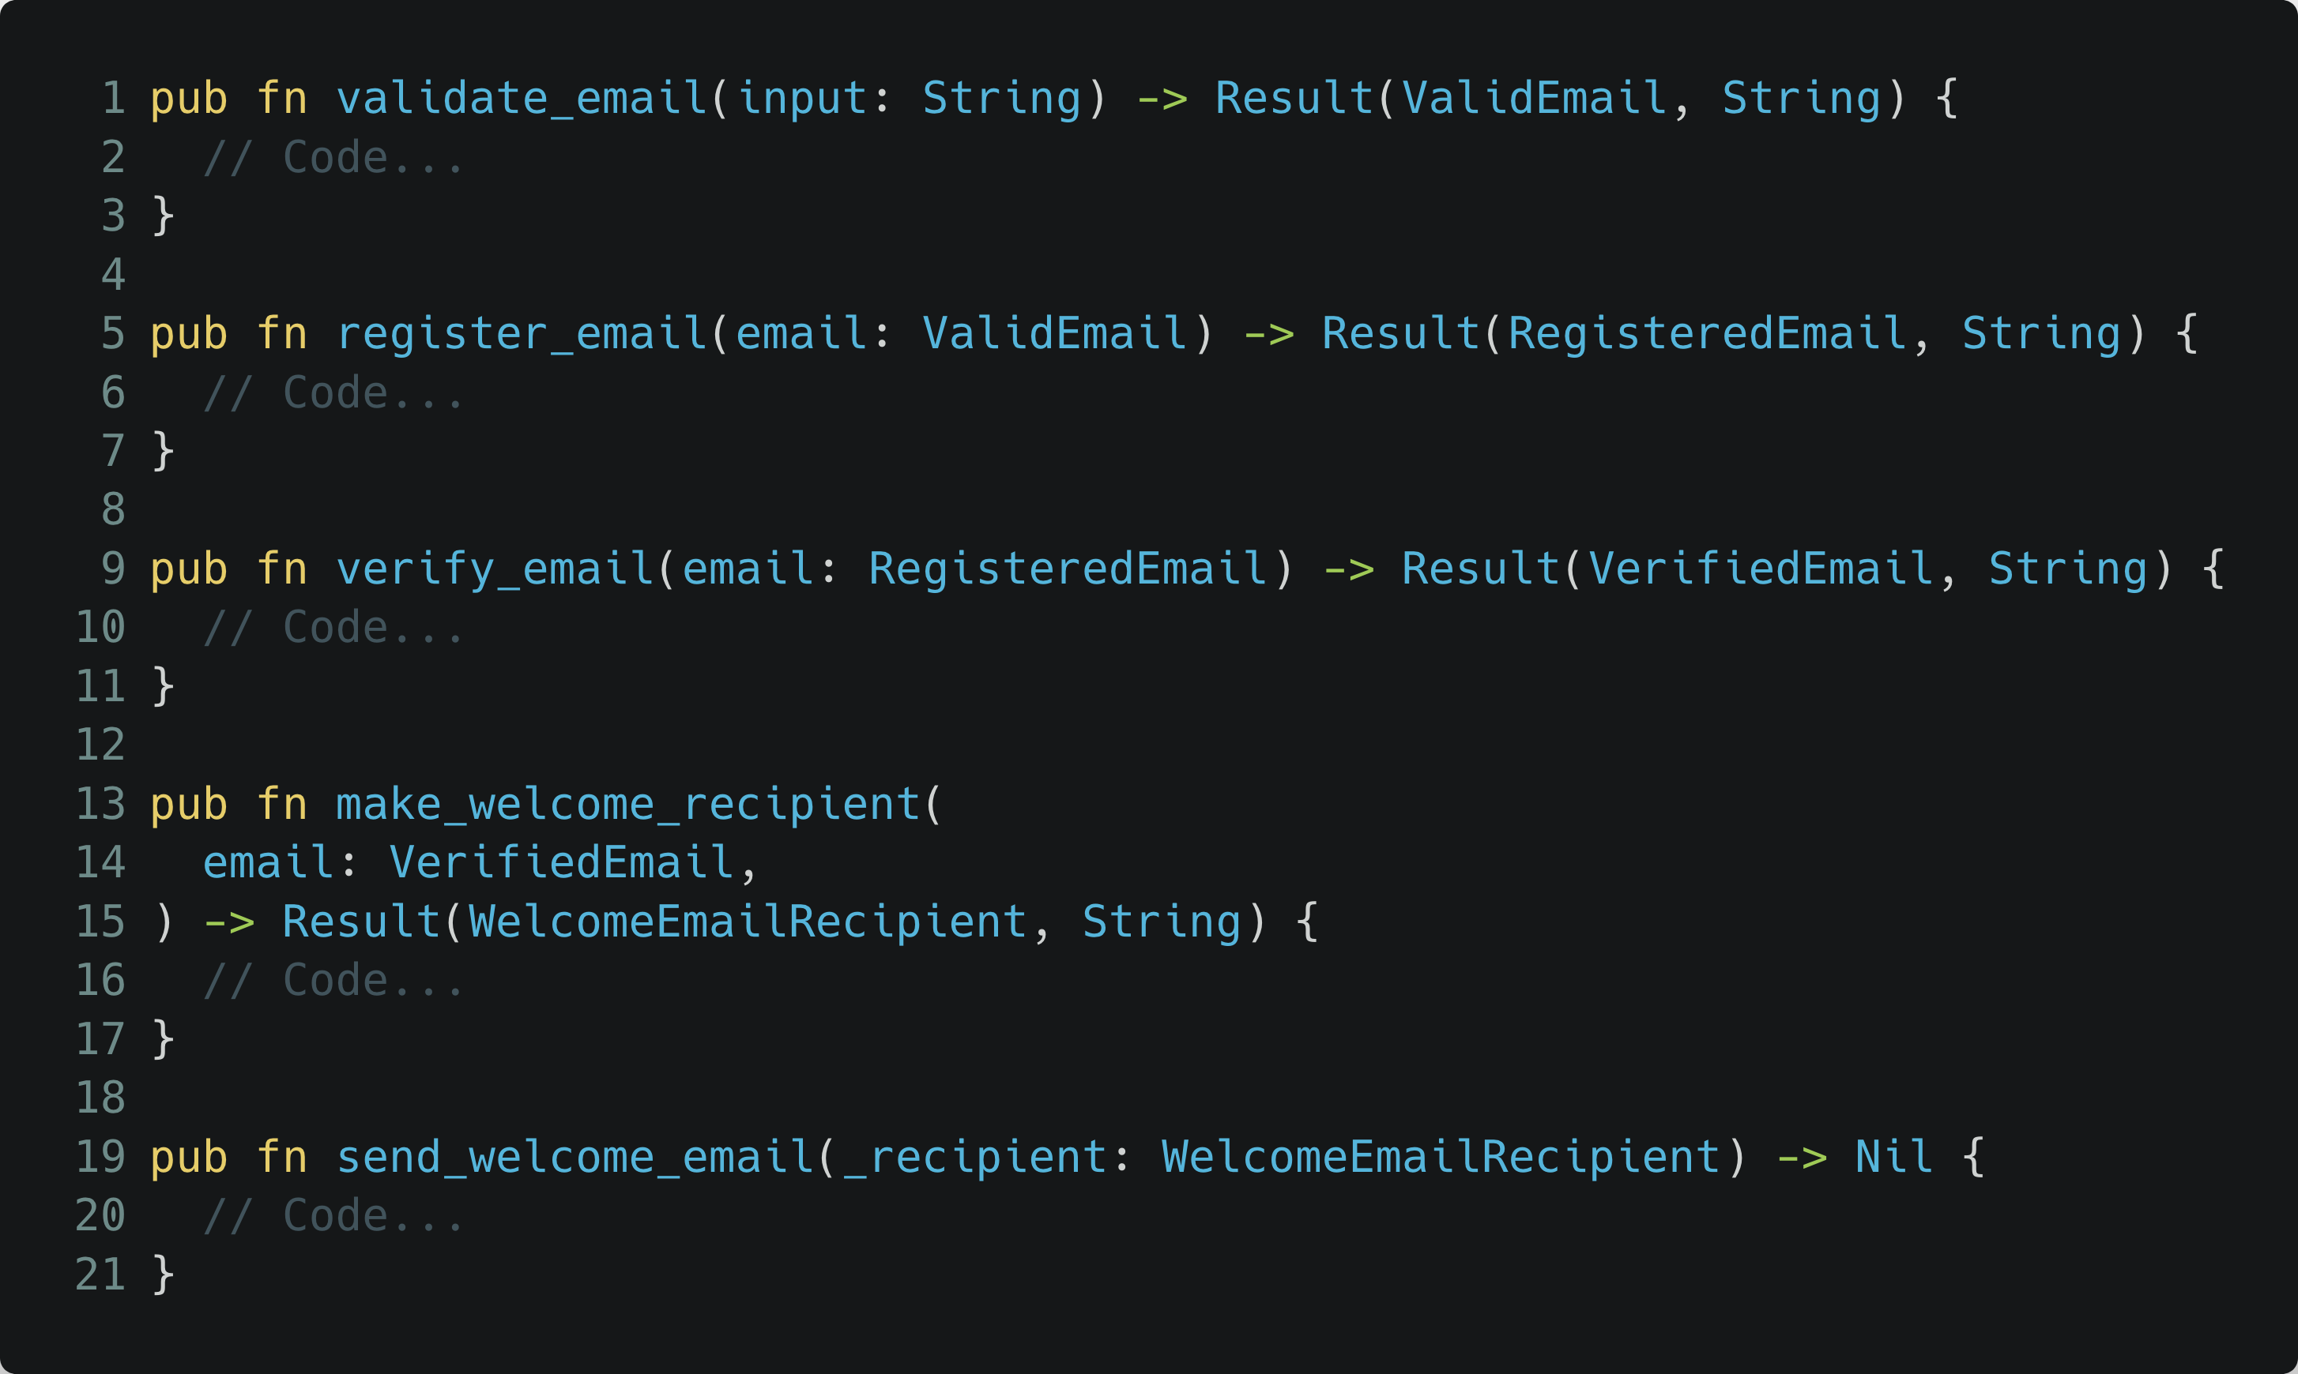
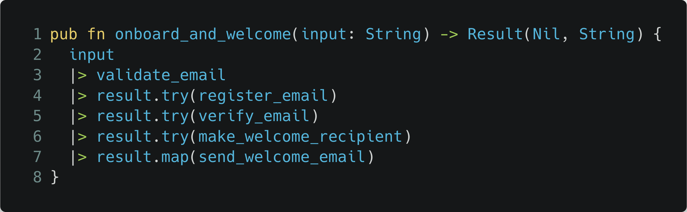
Web API
“Make Illegal States Unrepre­sentable”
email_validator.gleam
- Yaron Minsky
Batch jobs
welcome_sender.gleam
Other?
newsletter_sender.gleam
dark_pattern_sender.gleam
All forced to validate!

Slide 41
“Make Illegal States Unrepre­sentable”
- Yaron Minsky

Slide 42
“Make Illegal States Unrepre­sentable”
- Yaron Minsky

Slide 43
“Make Illegal States Unrepre­sentable”
- Yaron Minsky

Slide 44
Web API
“Make Illegal States Unrepre­sentable”
email_validator.gleam
- Yaron Minsky
Batch jobs
welcome_sender.gleam
Other?
newsletter_sender.gleam
dark_pattern_sender.gleam
All forced to validate!

Slide 45

What I want you to remember:
Use your technical skills to amplify your voice (for good)
Q
u
e
s
t
i
o
n
s
?
Use types to make illegal states a compile-time issue

Slide 46
What I want you to remember:
Use your technical skills to amplify your voice (for good)
Q
u
e
s
t
i
o
n
s
?
Use types to make illegal states a compile-time issue

